Slide 1
English
Unit 2 – Sport
WALT:
6Wc.01: Write a sequence of instructions.

Slide 2



WALT: Write a sequence of instructions.
I can use “should”, “must” and “need to” write a sequence advice or instructions.
I can use “shouldn’t”, “mustn’t” and “don’t need” to write advice or instructions.
I can give reasons for my advice or instructions.

Slide 3
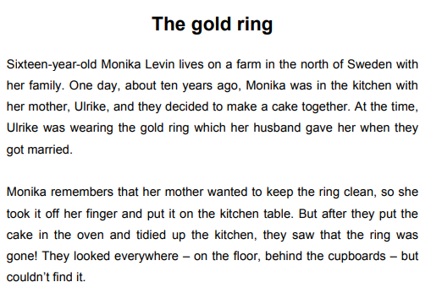
Retrieval Practice
WALT: Write a sequence of instructions.

Slide 4
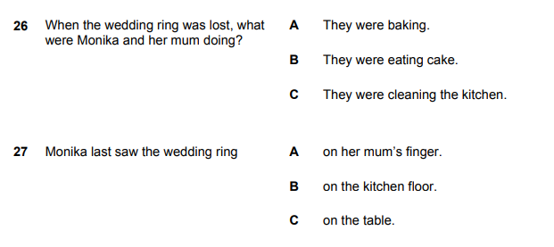
Retrieval Practice
WALT: Write a sequence of instructions.

Slide 5
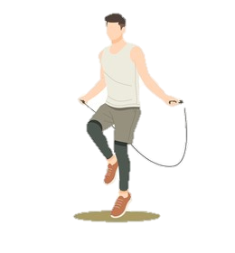


Starter – What exercises would you have in your own warm up?
WALT: Write a sequence of instructions.

Slide 6
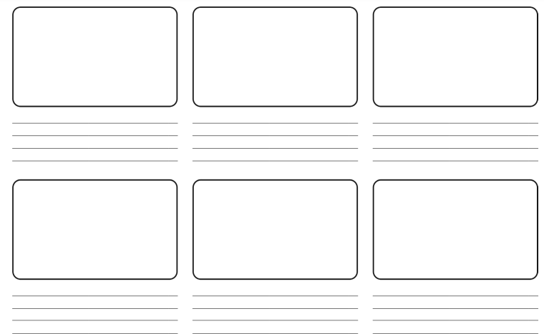
WALT: Write a sequence of instructions.
Create your own warm up using the template.

Slide 7
WALT: Write a sequence of instructions.
I can use “should”, “must” and “need to” write a sequence advice or instructions.
I can use “shouldn’t”, “mustn’t” and “don’t need” to write advice or instructions.
I can give reasons for my advice or instructions.

Slide 8

WALT: Write a sequence of instructions.
Create your own warm up using the template.
You must always stretch before you do any exercise.
You don’t need to skip for long.
You need to do some jumping jacks in order to raise your heart rate.

Slide 9
WALT: Write a sequence of instructions.
I can use “should”, “must” and “need to” write a sequence advice or instructions.
I can use “shouldn’t”, “mustn’t” and “don’t need” to write advice or instructions.
I can give reasons for my advice or instructions.

Slide 10

Plenary – Lead the class in your warm up.
WALT: Write a sequence of instructions.

